Slide 1
Design and Verification of a Complete Application Specific IC
Kevin Cao, Whitley Forman, Dhruvit Naik, Zachary Nelson and Juliann Swift
Advisors: Dr. Orlando Hernandez and Dr. Larry Pearlstein

Slide 2
Project Overview

Slide 3
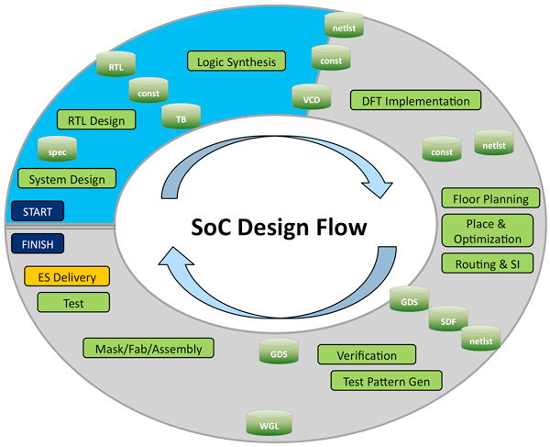

Slide 4
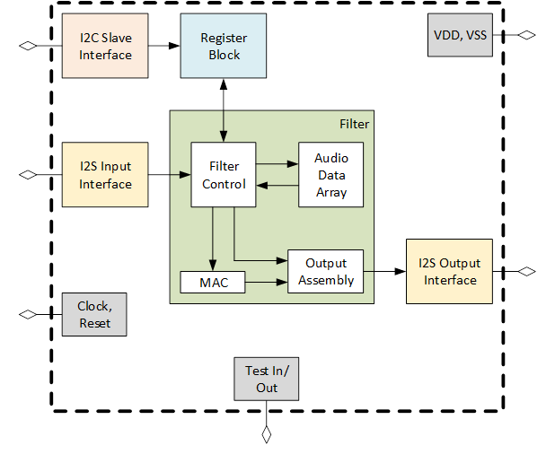
Chip Overview Diagram

Slide 5
Block Name | Signal Name | Direction | Bits | Comment
chip
 | clk | in | 1 | master clock, up to 100MHz
 | rst | in | 1 | reset
 | i2c_scl | in | 1 | I2C serial clock
 | i2c_sda | in/out | 1 | I2C serial data
 | i2si_sck | in | 1 | I2S bit clock
 | i2si_ws | in | 1 | I2S word select
 | i2si_sd | in | 1 | I2S serial data
 | i2so_sck | out | 1 | I2S bit clock
 | i2so_ws | out | 1 | I2S word select
 | i2so_sd | out | 1 | I2S serial data
 | block?_gpio | in/out | 8 | read registers for direction and value
i2c
 | clk | in | 1 | clock
 | rst | in | 1 | reset
 | i2c_scl | in | I2C Serial Clock | serial clock
 | i2c_sda_in | in | I2C Serial Data | external pin combines in and out using open drain
 | i2c_sda_out | out | I2C Serial Data | external pin combines in and out using open drain
 | i2c_op | out | 1 | 1: write 0: read
 | i2c_addr | out | 32 | register address
 | i2c_wdata | out | 32 | data to be written for a write op
 | i2c_rts | out | 1 | ready to send
 | i2c_rtr | in | 1 | ready to receive
 | i2c_rdata | in | 32 | read return data
 | i2c_xfc | in | 1 | read data transfer complete
 | rf_i2c_reg_indir_addr | in | 11 | address register used for indirect addressing via i2c
 | ro_i2c_reg_indir_data | in | 8 | data access register
reg
 | clk | in | 1 | clock
 | rst | in | 1 | reset
 | reg_op | in | 1 | 1: write 0: read
 | reg_addr | in | 32 | register address
 | reg_wdata | in | 32 | data to be written for a write op
 | reg_rts | in | 1 | ready to send
 | reg_rtr | out | 1 | ready to receive
 | reg_rdata | out | 32 | read return data
 | reg_xfc | out | 1 | read data transfer complete
 | i2s_inoverrun | in | 1 | will turn into sticky bit
i2si
 | clk | in | 1 | Master Clock
 | rst | in | 1 | Reset
 | i2si_sck | in | 1 | Digital Audio Bit Clock (max of 48kHz)
 | i2si_ws | in | 1 | Word Select (Left/Right Audio Channel)
 | i2si_sd | in | 1 | Digital Audio Serial Data
 | i2si_rtr | in | 1 | Ready to Receive
 | i2si_rts | out | 1 | Ready to Send
 | i2si_en | in | 1 | i2s input is enabled
 | i2si_lft | out | 16 | Left Parallel Digital Audio
 | i2si_rgt | out | 16 | Right Parallel Digital Audio
 | ro_fifo_overrrun | out | 1 | Input Audio FIFO Overrun
 | rf_bist_en | in | 1 | Built in Self-Test (BIST)
 | rf_bist_start_val | in | 16 | Start Value
 | rf_bist_inc | in | 8 | Increment
 | rf_bist_up_limit | in | 16 | Upper Limit
i2so
 | clk | in | 1 | clock
 | rst | in | 1 | reset
 | i2so_sck_out | out | 1 | digital audio bit clock (max 48kHz)
 | i2so_sck_in | in | 1 | digital audio bit clock (max 48kHz)
 | i2so_ws_out | out | 1 | word select (left right audio channel)
 | i2so_ws_in | in | 1 | word select (left right audio channel)
 | i2so_sd | out | 1 | digital audio serial data
 | i2so_lft | in | 16 | left parllel digtal audio
 | i2so_rgt | in | 16 | right parllel digital audio
 | i2so_rts | in | 1 | ready to send
 | i2so_rtr | out | 1 | read to receive
 | rf_i2so_clk2sck_div | in | 16 | half of the clock frequency divided by this #
 | ro_fifo_underrun | out | 1 | input audio fifo underrun
filter
 | clk | in | 1 | clock
 | rst | in | 1 | reset
 | filter_aud_in_lft | in | 16 | left parllel digtal audio
 | filter_aud_in_rgt | in | 16 | right parllel digital audio
 | filter_aud_in_rts | in | 1 | ready to send
 | filter_aud_in_rtr | out | 1 | read to receive
 | filter_aud_out_lft | out | 16 | left parllel digtal audio
 | filter_aud_out_rgt | out | 16 | right parllel digital audio
 | filter_aud_out_rts | out | 1 | ready to send
 | filter_aud_out_rtr | in | 1 | read to receive
 | rf_filter_shift | in | 4 | number of bit postions to shift after filter accumulator
 | rf_filter_clip_en | in | 1 | 1- performs clipping 0- no cliping
 | rf_filter_coeff# | in | 16 | filter coeffecient

Slide 6
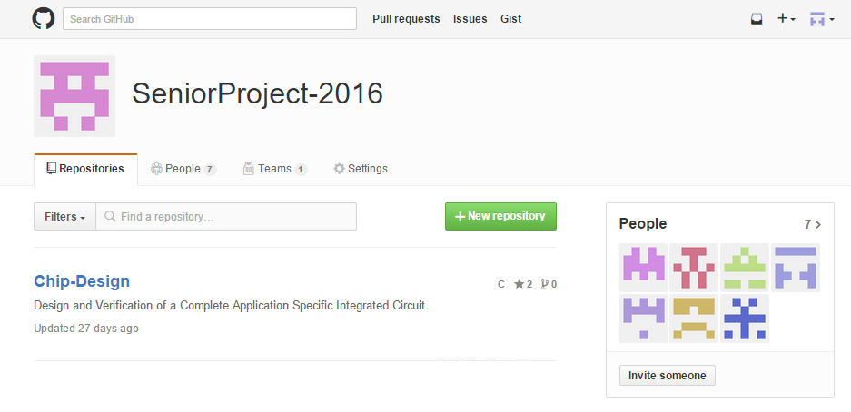
GitHub Revision Control

Slide 7
GitHub File Hierarchy
rtl (register-transfer level)
chip.v (top level)
i2c_slave.v
i2s_in.v
i2s_out.v
filter.v
register.v
reg
synth (synthesis)
dv (design verification)
testbenches
stimulus
scripts
utils (utilities)
docs (documents)
core (CORE 9 files)

Slide 8
Address | Register Name | Field Name | Bits | Description | RO/WO/RW | Default Value
0x000 | CHIP_INFO
 |  | ro_chip_id | 7:0 | Fixed Chip ID | RO | 0x1234
 |  | ro_revision_id | 15:8 | Fixed Revision ID | RO | 0
0x004 | CONTROL
 |  | rf_soft_reset | 1 | 0- normal operation. 1- assert soft reset | RW | 0
 |  | rf_i2si_bist_en | 1 | 0- audio sorce is i2si. 1- audio source is BIST | RW | 0x1
 |  | rf_filter_shift | 4 | number of bit postions to shift after filter accumulator | RW | 0xF
 |  | rf_filter_clip_en | 1 | 1- performs clipping 0- no cliping | RW | 0x1
 | optional? | rf_i2si_dec_factor | 4 | sample and hold audio values | RW | 0
 | optional? | rf_i2so_dec_factor | 4 | sample and hold audio values | RW | 0
0x008 | I2S_CLOCK_CONTROL
 |  | rf_i2so_clk2sck_div | 16 | half of the clock frequency divided by this # | RW | 0x40
0x00C | STATUS
 |  | trig_fifo_overrun | 1 | fifo overrun clear | WO | NA
 |  | ro_fifo_overrun | 1 | input audio fifo overrun | RO | 0
 |  | trig_fifo_underrun | 1 | fifo underrun clear | WO | NA
 |  | ro_fifo_underrun | 1 | output audio fifo underrun | RO | 0
0x010 | BIST
 |  | rf_i2si_bist_start_val | 12 | start value of sawtooth wave | RW | 0x800
 |  | rf_i2si_bist_incr | 8 | increment of sawtooth wave | RW | 0x010
 |  | rf_i2si_bist_upper_limit | 12 | upper limit of the sawtooth wave | RW | 0x7FF
0x014 | I2C_REG_INDIR_ADDR
 |  | rf_i2c_reg_indir_addr | 11 | address register used for indirect addressing via i2c | RW | 0
0x018 | I2C_REG_INDIR_DATA
 |  | ro_i2c_reg_indir_data | 8 | data access register | RO | NA
0x040 | FILT_COEFFS_0_1
 |  | rf_filter_coeef0 | 15:0 | Filter Coefficient 0 | RW | 0x0
 |  | rf_filter_coeef1 | 31:16 | Filter Coefficient 1 | RW | 0x0
0x044 | FILT_COEFFS_2_3
 |  | rf_filter_coeef2 | 15:0 | Filter Coefficient 2 | RW | 0x0
 |  | rf_filter_coeef3 | 31:16 | Filter Coefficient 3 | RW | 0x0
0x43C | FILT_COEFFS_510_511
 |  | rf_filter_coeef510 | 15:0 | Filter Coefficient 510 | RW | 0x0
 |  | rf_filter_coeef511 | 31:16 | Filter Coefficient 511 | RW | 0x0

Slide 10
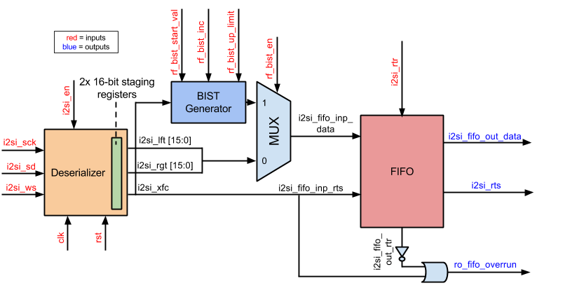
i2si.v Block Diagram

